Slide 1

Intro to Python Objects – Part 1

Slide 2
Python Objects
Variables are simply names that are used to keep track of information.
Variables are created when they are first assigned a value.
Variables must be assigned before they can be used.
Variables will take the form of Python objects. We will use 3 different objects:
Numbers: integers, real number, etc …
Strings: ordered sequences of characters
Lists: ordered collection of objects
Python objects are dynamically typed, meaning you don’t have to declare the type of the variable upon creation.

Slide 3
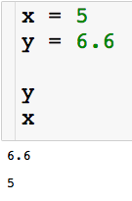
Creating Variables
Let’s create our first variables
Code cell
The code executes from top to bottom

Slide 4
Creating Variables
Let’s create our first variables

Slide 5
Creating Variables
Let’s create our first variables. These variables with be numbers.

Slide 6
Creating Variables
Let’s create our first variables

Slide 7
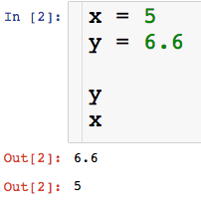
Creating Variables
Let’s create our first variables
Code cell
A couple of things about Jupyter

Slide 8
Creating Variables
Let’s create our first variables
Code cell
Order in which cells have been run
A couple of things about Jupyter

Slide 9
Creating Variables
Let’s create our first variables
Code cell
Order in which cells have been run
Output, we get this by typing variable names
A couple of things about Jupyter

Slide 10
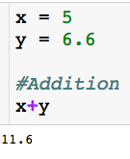
Arithmetic Operations
# = comment

Slide 11
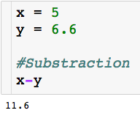
Arithmetic Operations

Slide 12
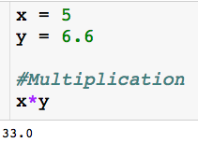
Arithmetic Operations

Slide 13
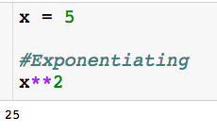
Arithmetic Operations

Slide 14
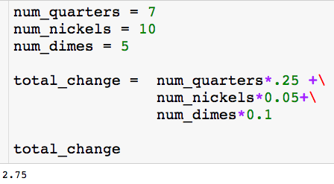
Using Variables
Use description variable name
Rule for creating variable names:
Be descriptive and separate words with underscore
No spaces
No punctuation other than underscore

Slide 15
Using Variables
Use description variable name
The backslash lets you continue your block of code on the next line.

Slide 16
Using Variables
Use description variable name
I can create variables that are a function of other variables
The backslash lets you continue your block of code on the next line.

Slide 17
Using Variables

Slide 18
Using Variables

Slide 19
Using Variables

Slide 20
Using Variables

Slide 21
Using Variables
This just prints the value stored in the variable so we can see it.

Slide 22

Using Variables
You will often find yourself updating variables:
Some other code executes…want to add 1 to count

Slide 23
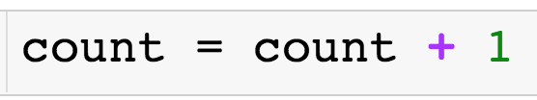
Using Variables
You will often find yourself updating variables:
Some other code executes…want to add 1 to count

Slide 24
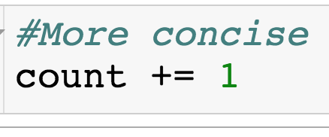
Using Variables
You will often find yourself updating variables:
Some other code executes…want to add 1 to count

Slide 25
Booleans
The Boolean type can be viewed as numeric in nature because its values (True and False) are just customized versions of the integers 1 and 0.
The True and False behave in the same way as 1 and 0, they just make the code more readable.
Let us check if specified conditions are true

Slide 26
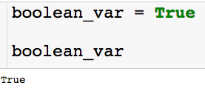

Booleans
Creating boolean variable:
Note that the boolean does behave exactly like a 1:

Slide 27



Conditional Tests
Sets the variables x equal to 5.
Asks if x is equal to 5. Returns boolean.
Asks if x is less than or equal to 4. Returns boolean.

Slide 28
Strings
Python strings are an ordered collection of characters (usually these characters will be letters and numbers) used to represent text.
String are created by placing single or double quotation marks around a sequence of characters.
Strings support the following operations
concatenation (combining strings)
slicing (extracting sections)
Indexing (fetching by offset)
the list goes on ….

Slide 29
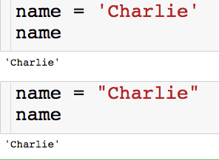
Strings
Let’s create our first strings
You can create a string with either single or double quotes.
There is a left to right ordering that we will explore on the next slide

Slide 30

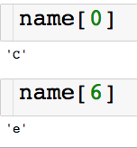
Indexing Strings
We can access the characters of the string through their index
Slicing single characters through e index:
(pretend there aren’t spaces between the letters)

Slide 31

Slicing Strings
We can access the characters of the string through their index
Slicing contiguous characters:
(pretend there aren’t spaces between the letters)
start
finish (non-inclusive)

Slide 32
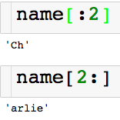
Slicing Strings
We can access the characters of the string through their index
Slicing contiguous characters:
(pretend there aren’t spaces between the letters)
If start index is left blank defaults to 0
If end index is left blank defaults to end of the string

Slide 33
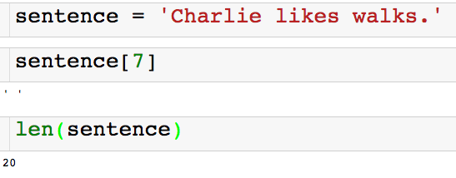
Slicing Strings
We can access the characters of the string through their index
Spaces and punctuation count in the indexing of a string!

Slide 34
Slicing Strings
We can access the characters of the string through their index
Returns the number of characters in the string

Slide 35
String Concatenation
I can combine strings using the + operator.
So the + operator between two numbers add them and the + operator between two strings concatenates them! This is called polymorphism.

Slide 36
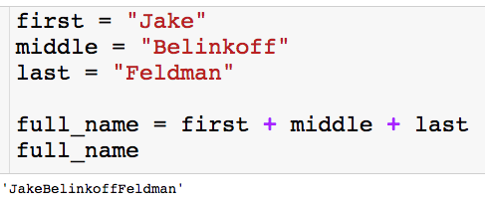
String Concatenation
I can combine strings using the + operator.
So the + operator between two numbers add them and the + operator between two strings concatenates them! This is called polymorphism.
If we want a space, we have to say so.

Slide 37
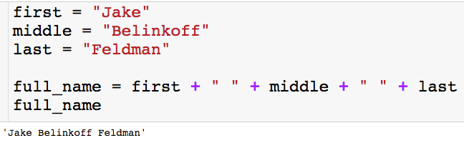
String Concatenation
I can combine strings using the + operator.
So the + operator between two numbers add them and the + operator between two strings concatenates them! This is called polymorphism.
With the space

Slide 38
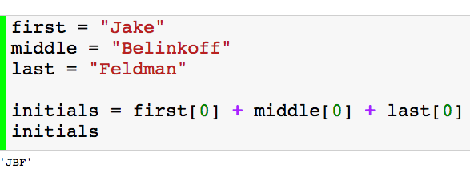
String Concatenation
I can combine strings using the + operator.
So the + operator between two numbers add them and the + operator between two strings concatenates them! This is called polymorphism.
Another example

Slide 39
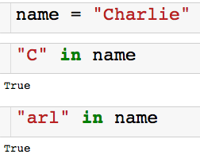

Using In
We can use the keyword in to check if a string is contained in another string.
There is also a not in:

Slide 40
Lists
Ordered collection of arbitrary objects.
There is a left to right ordering (just like string).
Can contain numbers, string, or even other lists.
Elements accessed by offset.
You can fetch elements by index (just like string).
You can also do slicing and concatenation.
Variable in length and arbitrarily nestable.
Lists can grow and shrink in-place.
You can have lists of lists of lists…

Slide 41
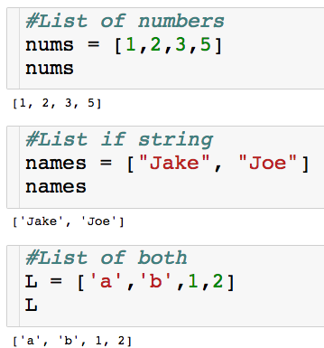
Lists
Lets create our first lists
Elements enclosed in square brackets

Slide 42
Lists
Lets create our first lists
Elements enclosed in square brackets.
Elements separated by commas.

Slide 43

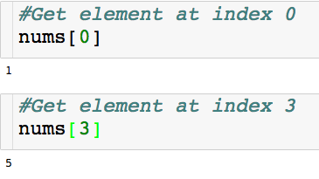
Indexing Lists
Indexing for lists is very similar to strings

Slide 44
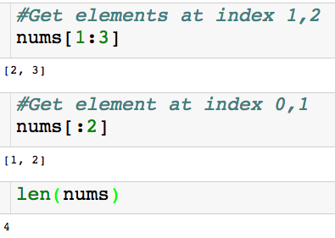
Slicing Lists
Slicing for lists I also very similar to strings
Returns lists

Slide 45
Slicing Lists
Slicing for lists I also very similar to strings
Returns lists
Returns # of elements in list

Slide 46

Nested Lists
Creating a nested list:
There are two elements in the list nested_L.
There is a list of numbers in index 0.
There is a list of string of index 1.

Slide 47
Indexing Nested Lists
Creating a nested list:
How do I pick out the 2 in the first list?

Slide 48

Indexing Nested Lists
Creating a nested list:
How do I pick out the 2 in the first list?
First pick out the list of numbers, then from that pick out the
Stack the indexing

Slide 49
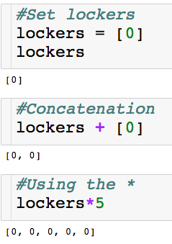
Polymorphism with Lists
The + and * operator work on lists as well!

Slide 50
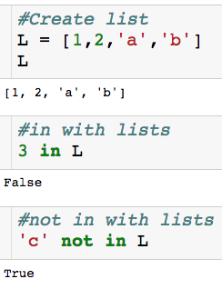
Using in with Lists
Keywords in and not in work with lists as well.

Slide 51
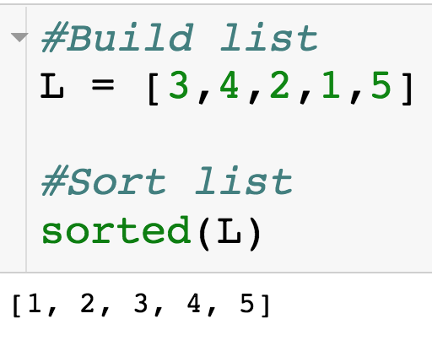
Sorting Lists
We can sort lists with the built-in sorted() function.
Returns sorted version of list

Slide 52
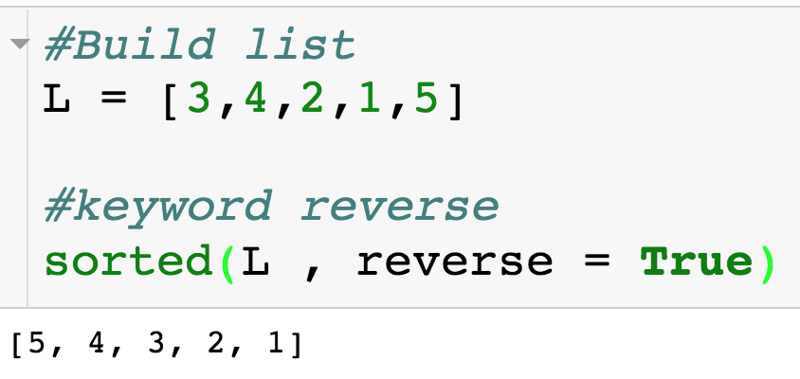
Sorting Lists
We can sort lists with the built-in sorted() function.
Sort list descending
Default is reverse = False

Slide 53
Sorting Lists
We can sort lists with the built-in sorted() function.
Sort list descending
Default is reverse = False
Next session we will see how to sort L “inplace”.

Slide 54
Intro to Python Objects – Part 2

Slide 55
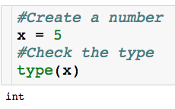
Checking the Type
For any variable, we can check what kind of object it is:
Built in type function

Slide 56
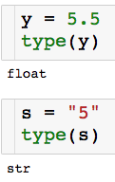
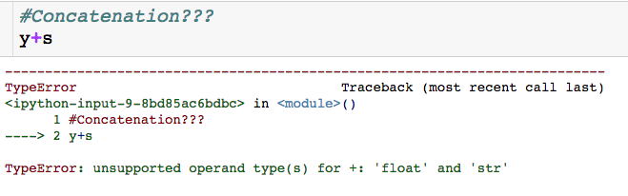
Why the Type Matters
We can’t concatenate a string and a number…and we shouldn’t be able

Slide 57
Why the Type Matters
type() can be helpful for debugging
Another reason to have descriptive variable names

Slide 58
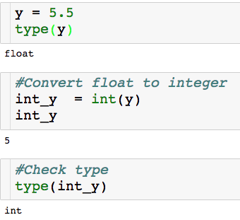
Converting Types
Built in int() function
int() is one way to perform a floor operation

Slide 59
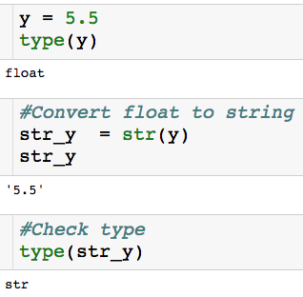
Converting Types
Built in str() function

Slide 60
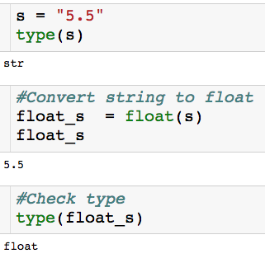
Converting Types
Built in float() function

Slide 61
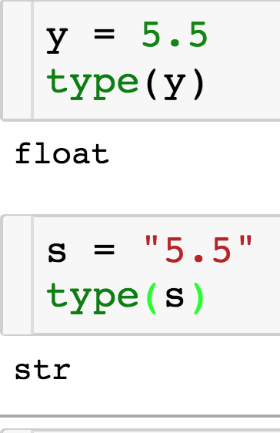
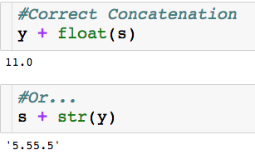
Why the Type Matters

Slide 62
Digging Deeper into Python Objects
Every Python Object is either mutable or immutable
Mutable: Can be changed once created - a list L can have its first element replaced.
Immutable: Can’t be changed once creating – a string S cannot have its first letter changed.

Slide 63
Digging Deeper into Python Objects
Every Python Object is either mutable or immutable
Mutable: Can be changed once created - a list L can have its first element replaced.
Immutable: Can’t be changed once creating – a string S cannot have its first letter changed.
What we know so far:
Numbers = Immutable
String = Immutable
Lists = Mutable

Slide 64
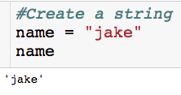
Example of Immutability
Let’s say I want to change the first letter of name to a “J”

Slide 65
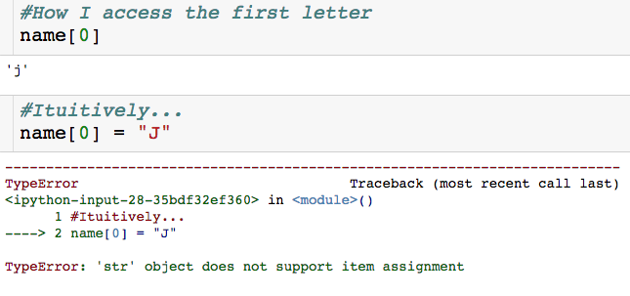
Example of Immutability
Let’s say I want to change the first letter of name to a “J”
Can’t change name once it is created!

Slide 66
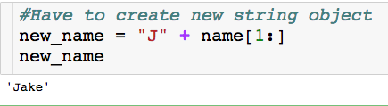
Example of Immutability
Let’s say I want to change the first letter of name to a “J”

Slide 67
Example of Immutability
Let’s say I want to change the first letter of name to a “J”
We will see an easier way to do this…

Slide 68
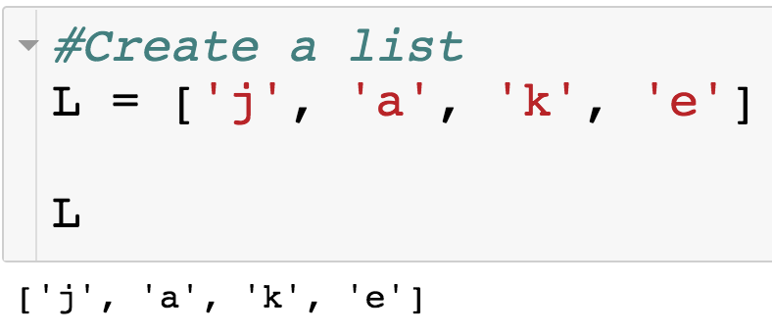
Example of Mutability
Let’s say I want to change the string in index 0 to a “J”.

Slide 69
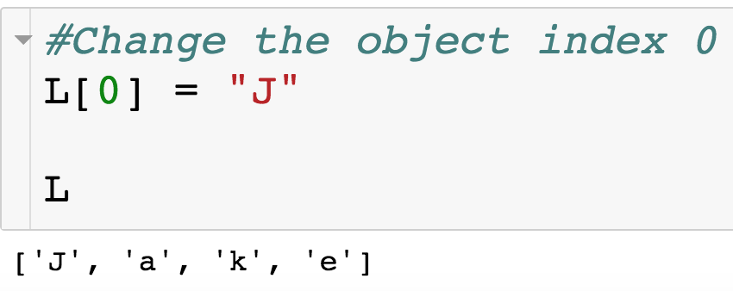
Example of Mutability
Let’s say I want to change the string in index 0 to a “J”.
Since lists are mutable, we change an any part of list after it has been created.

